Slide 1
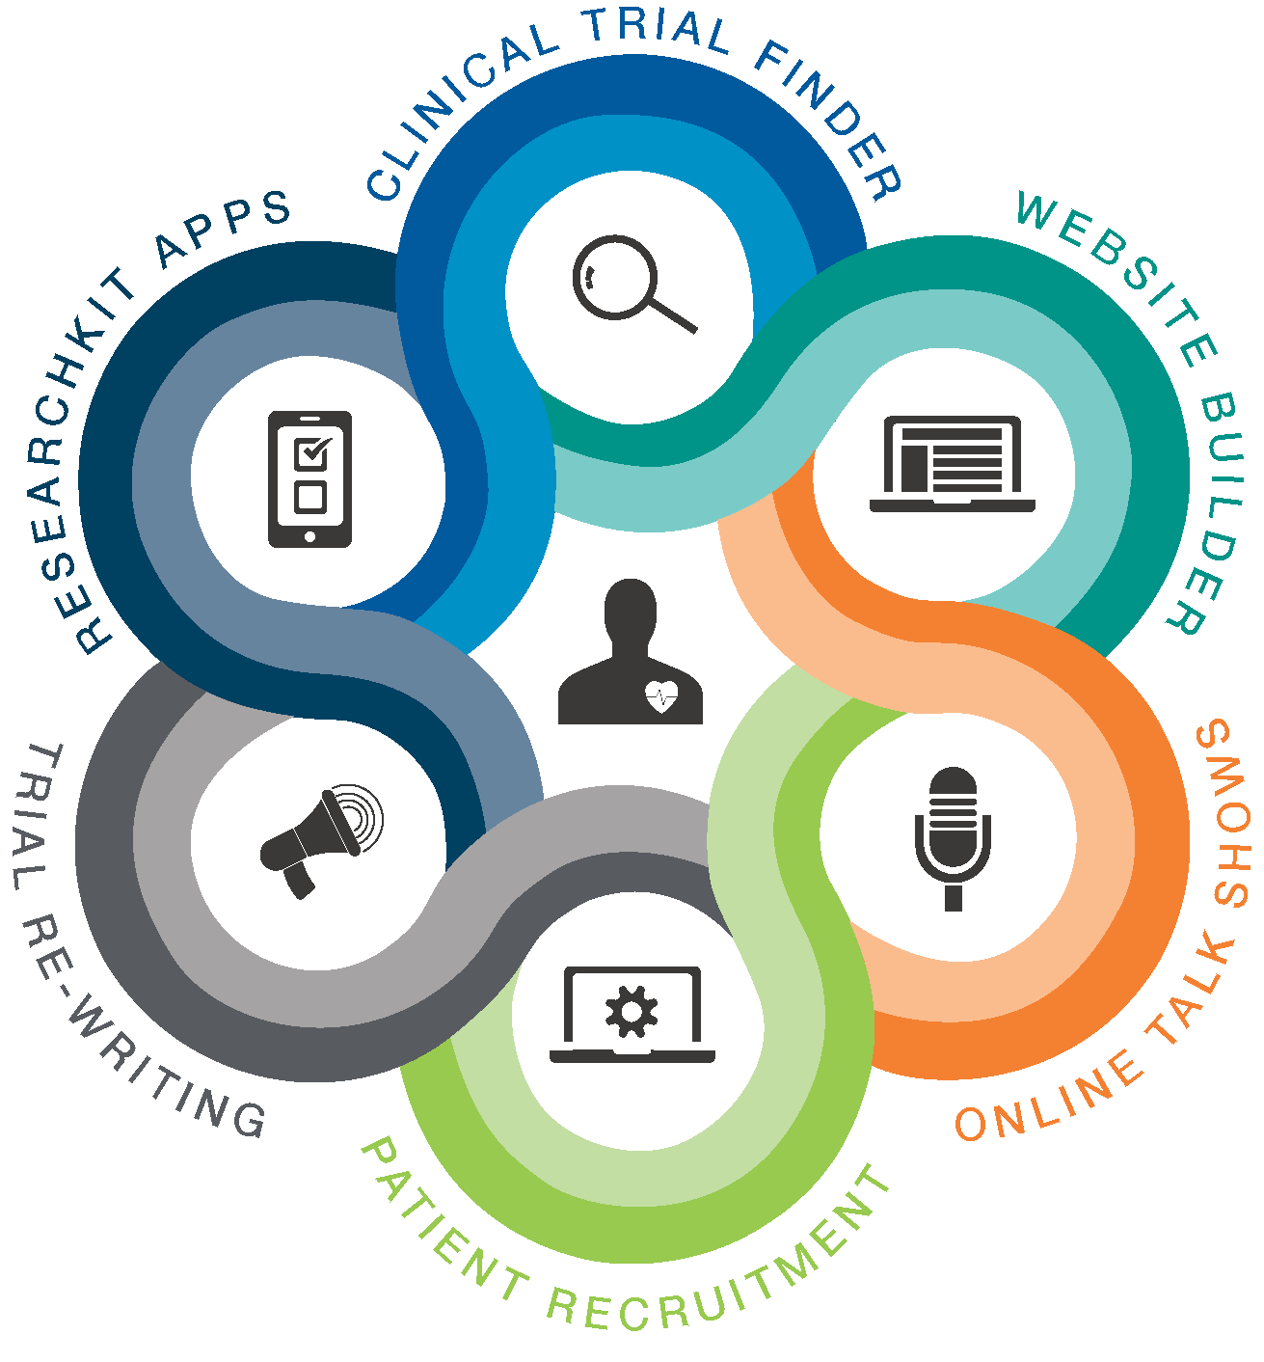
TRIALX.COM

Slide 2
Organizational Onboarding - 1

Slide 3
Know Your Company
Know Your Team
Know Your Products
Know Your Skills

Slide 4
KNOW YOUR COMPANY

Slide 5
JOINING TRIALX - Contributing to a great and compassionate mission

Slide 6










• Started by 2 Columbia University graduates
• Launch TrialX app with Google Health
• Partnership with Microsoft
• The New York Times mention
• University of Pennsylvania Medical Center as client
• Launch CureTalks talk show
• Dory trial finder live on MMRF website
• New York University Medical Center as client
• 8th Grade Media - a clinical trial rewriting service
• Launch of first Android ResearchKit Toolkit
• Launch of volunteer registry and Automated Referral Tracking
2008
09-10
11-12
13-14
2015
2016
• Cleveland Clinic as client
• NYC Venture competition winner
• BIDMC/Harvard as client
• First ever iPhone app and Twitter app on clinical trials
• University of Pennsylvania Medical Center as client
• Launch CureTalks talk show
• Dory trial finder live on MMRF website
• Dory trial finder live on PatientPower and OneVoice
• America Walks Study – First ResearchKit Study on iOS and Android
• Trialspace – Website builder and recruitment tracking

Slide 7

TRIALX
TrialX is your connection to patients. By bringing researchers and patients together, TrialX is accelerating clinical research to find cures for millions. We put the patient at the center and build solutions that work together seamlessly to meet the patient where they are. This helps them ﬁnd the trials they are looking for and connect with investigators close by.
The ecosystem of solutions that TrialX has created and continues to build upon is what we call the ‘TrialX NeXus’. It’s a multidimensional approach to building a robust online presence for clinical trials. TrialX NeXus provides sponsors, CROs and investigators the platform to launch trial websites in minutes, communicate with interested patients, view live dashboards to track referrals and reach the target audience through multiple inter-connected channels.

Slide 8
KNOW YOUR TEAM

Slide 9

Who are we: The Navy Seals of Healthcare Informatics.
What we do: We build solutions that most software companies cant
What is our USP: Domain expertise, Design and Rapid Development
Board
Sharib Khan
Official: Chief Executive Officer
Unofficial: Yogi
Chintan Patel
Official: Chief Technology Officer
Unofficial: Yoda
Aziz Rawat
Official: Chief Creative Officer
Unofficial: Don Draper
TBD
Business Development/Sales
Core Activities
General Activities
Shahid Ashraf
Official: Software Lead (Data)
Unofficial: Data Ninja
Project Lead: TI, GetHealth,
ML R&D
Nadeem Nazeer
Official: Software Lead (Semantics)
Unofficial: Semantics Ninja
Project Lead for: PVAI Data, HaVoc
Aamir Bhat
Official: Software Lead (Applications)
Unofficial: Applications Ninja
Project Lead: PVAI UI, Android
20
Yaseen Dar
Official: Software Lead (Products)
Unofficial: Godzilla
Project Lead: Turner, Custom iOS
Praveen Gupta
Official: Design Lead Unofficial: Logo Master
Danish Khan
Official: Operations Lead
Unofficial: The Boss
60
20
Priya Menon
Official: Client Support and Outreach
Unofficial: Brand Ambassador
20
Nadeem Nazeer
Official:Engineering Quality and Training
Unofficial: Professor
40
Zahid Ajaz
Senior Software Engineer (Data & Web)
Faizaan Wani
Senior Software Engineer (Data)
Owais Mushtaq
Senior Software Engineer (Web)
Harold Quilang
Senior Software Engineer (Web)
Ather Rashid
Senior Software Engineer (Web)
Shahid Ayoub
Senior Software Engineer (Web)
20
Priya Menon
Official: Learning & Development
Unofficial: Goddess
Mir Suhail
Software Engineer (Android)
Saahyl Rafiq
Software Engineer (Data)
40
Mohit Sharma
Software Engineer (UI)
20
Yaseen Majeed
Official: Community Organizer
Unofficial: Chota Godzilla
Shweta Misra
Content & Social Media
10
Intern/New Hire
Intern/New Hire
Ummer Akbar
Software Engineer (Android)
40

Slide 10
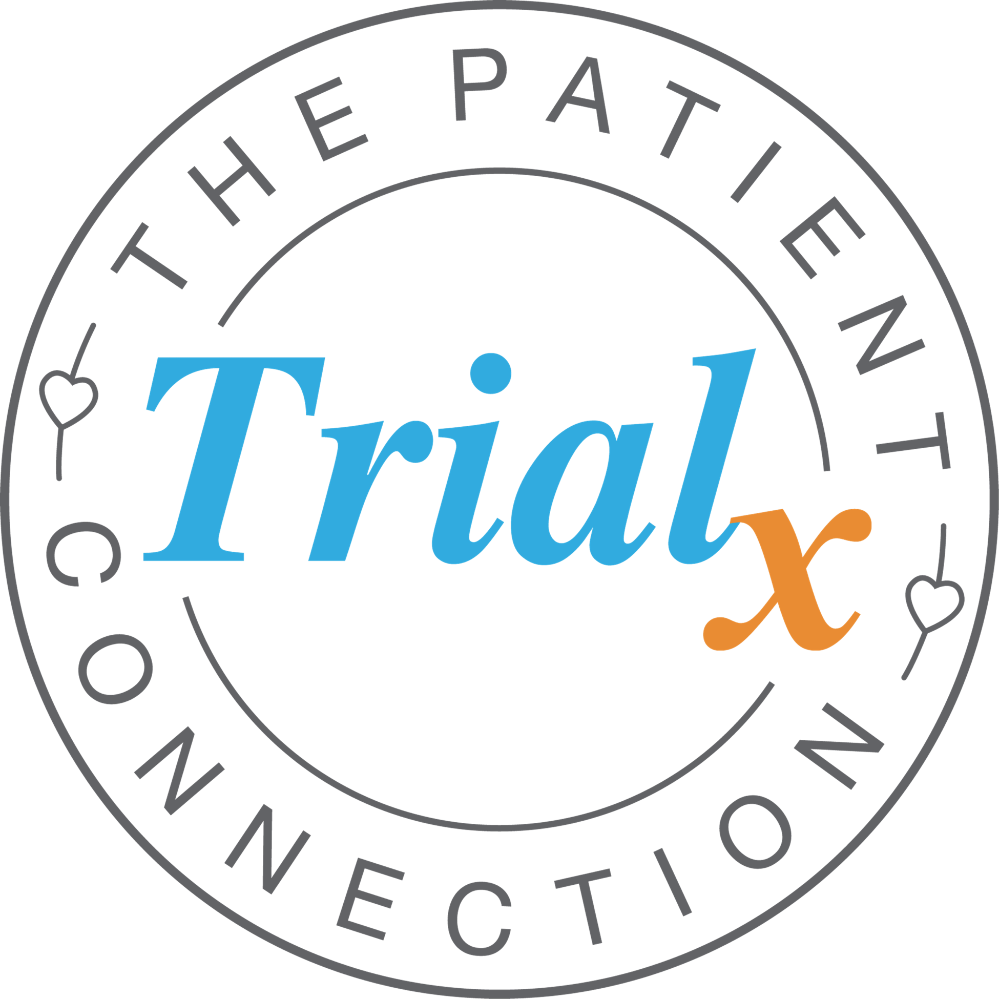
Who are we: The Patient Connection Company
What we do: We build solutions to connect patients to research
What is our USP: Domain expertise, Design and Rapid Development
Board
Sharib Khan
Chief Executive Officer
Chintan Patel
Chief Technology Officer
Aziz Rawat
Official: Chief Creative Officer
Unofficial: Don Draper
Robert Ryan
VP, Solutions (Goodfella)
Resource from Applied Informatics
90
Aamir Bhat
Software Architect (Appbakery)
Yaseen Dar
Official: Technology Lead
20
80
60
Priya Menon
Official: Client Support and Outreach
Praveen Gupta
Official: Design Lead
Harold Quilang
Senior Software Engineer (Appbakery)
Nasir Ahangar
Senior Software Engineer (iConnect)
Asreedh Nair
Senior Software Engineer (iConnect)
Nadeem Aslam
Software Engineer (iConnect)
Faisal Shafi
Software Engineer (iConnect)
Shweta
Content & Social Media
Zahid Ajaz
Senior Software Engineer (GetHealth)
40
20
60
80
Mir Suhail
Software Engineer (Appbakery - Android)
Shahid Ayoub
Senior Software Engineer (Appbakery)
Yaseen Majeed
Software Engineer (Appbakery -iOS)
Zaid Pathan
Software Engineer (Appbakery - iOS)
Anfas
Software QA/Testing
Intern/New Hire

Slide 11
Innovation Lab
Harold Quilang
Web Hacker
Praveen Gupta
Design Master
Sharib Khan
Idea Advisor
Chintan Patel
Hacking Advisor
Nasir Ahangar
UI Hacker
Shahid Ashraf
Ninja
Umer Bhat
UI Cadet
Aziz Rawat
Design Advisor
Nadeem Nazeer
Ninja
Aamir Bhat
Ninja
Yaseen Dar
Backup Ninjas
Faizaan Yousuf
Data Hacker
Mir Suhail
Android Hacker
Ather, Owais, Ayoub
Backup Web Hackers
Zahid, Saahyl
Backup Data Hackers
Yaseen Majeed
iOS Hacker

Slide 12
Point of Contact Matrix
Product | Business Concerns | Technical Issues
iConnect EDU | Robert | Nasir / Aniket
iConnect INDU | Robert | Yaseen
Appbakery | Priya / Robert | Shahid Ayoub
CureTalks | Priya / Robert | Umer Shafi
Patient Recruitment support programs | Robert / Erica | NA

Slide 13
KNOW YOUR PRODUCTS & CLIENTS

Slide 14

The TrialX NeXus
Website Builder
Patient Recruitment
Clinical Trial Finder
Mobile Study Apps
Trial Re-writing
Online Talkshows

Slide 15



iConnect: Patient Recruitment Management System
Appbakery: Mobile Research Study Apps
CureTalks: Online talk show on health wellness

Slide 16
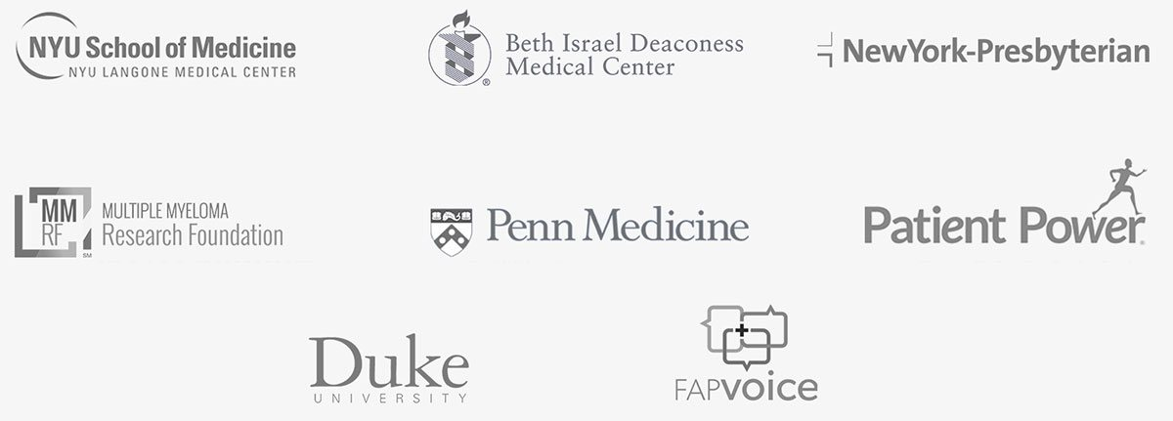

Slide 17
KNOW YOUR SKILLS

Slide 18
Tools and Technologies
Web - Django/Python, RoR, React.js, REST APIs, Cloud Voice/SMS
Mobile - iOS, Android, Apple ResearchKit/CareKit
Big Data - Spark, Hadoop, R, MongoDB, ETL, NLP, Machine Learning
IoT - Wearables, Devices APIs
Collaboration tools
Confluence
Development tools
Jira
Git

Slide 19
CHECKLIST
Data Science, Big data tools & concepts:
ETL
Crawling/Scraping (Scrapy etc).
Elasticsearch, Apache big data tools like Hadoop etc.
Data visualization - types/uses of graphs etc.
Scaling processing of large files/data(XML, JSON).
R or Pandas basics.
Git, Git Ethics
Python, Virtualenv
Linux Commands
Vim
Database, SQL
Regular expressions
Operating Systems(Mgmt. cmds, process mgtm., file mgmt., Network mgmt. )
Software engineering, Object-Oriented Programming Principles
Agile, System analysis and design, problem analysis, (e.g: Capturing design in ERD/DFD/Sequence/Time series diagrams)
Web protocols ( e.g: HTTP, FTP, SFTP)
Apache HTTP Server
Basics/Intermediate: Django, HTML, CSS, JS
Online problem solving (hackerrank etc)

Slide 20
OPERATIONS

Slide 21
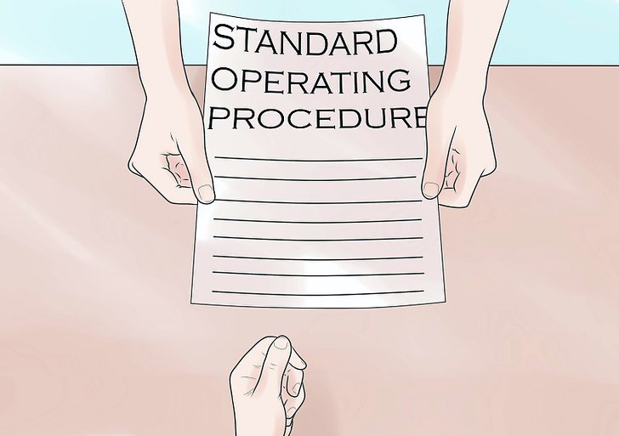

Slide 22
What is SOP?
Documents which describe the operations of a certain work or job to ensure its quality
A set of compulsory instructions, procedures or steps written for individuals to follow to complete the job safely
Maximizes operational and production requirements
Purpose of a SOP is to carry out the operations correctly and always in the same manner

Slide 23

Why are SOPs required?
Streamlined and proceduralized operations improve quality.
The marketplace increasingly demands partners and suppliers be in compliance with industry standards and government regulations.

Slide 24
“Quality and security is everyone’s responsibility.“

Slide 25
TRIALX SOPs
https://docs.google.com/document/d/1IbLKxFm-2vhWqi4cadnb1zWDdiZzbDEsptSJsAU1SVQ/edit
General
Quality
Information Technology
Project Management
System Development
Security Privacy and Business Continuity
Support
Notes:
https://docs.google.com/document/d/1IbLKxFm-2vhWqi4cadnb1zWDdiZzbDEsptSJsAU1SVQ/edit
https://drive.google.com/drive/folders/1WpG0TnidxAbTTb6fp5C8kqRqqDCoHW4L

Slide 26
SOP Maintenance
TrialX SOP Roles and Responsibilities
https://docs.google.com/document/d/1tZeKtg7NQsyHEo7PSyTV1QgdRbw6j3et6mHghdRf5Mg/edit
Notes:
https://docs.google.com/document/d/1tZeKtg7NQsyHEo7PSyTV1QgdRbw6j3et6mHghdRf5Mg/edit

Slide 27
SDLC

Slide 28
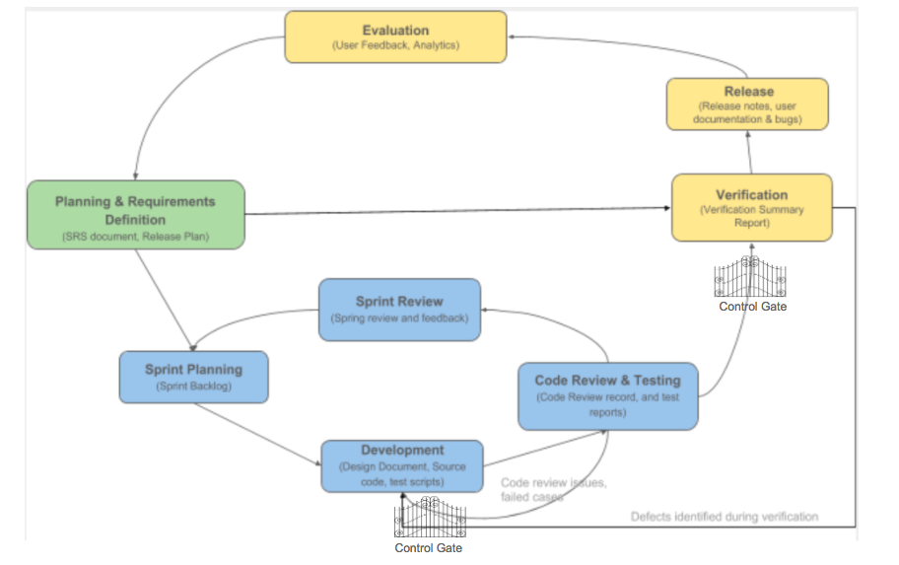

SDLC Overview
Phase 1: Business / Functional Requirements
Phase 2: Design Requirements
Phase 3: Development
Phase 4: Validation / Quality Assurance
Phase 5: Deployment
Control Gate

Slide 29
Thank you!
Quality is not an Act, it’s a Habit.

